Slide 1
Comparing Fractions
Like and Unlike
Unit 5 – Task #9

Slide 2
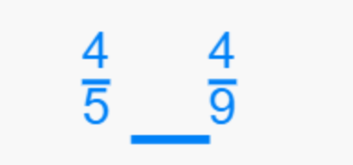
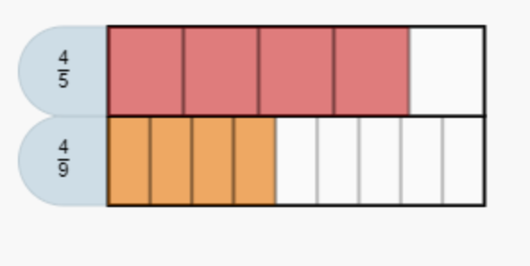
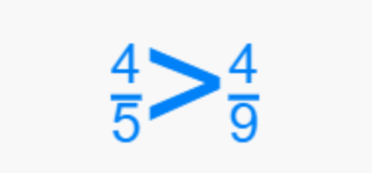
Like Fractions - Numerators
Notice
However
So
Same numerator, so we are getting the same number of shaded parts.
Our denominators are different, So our equal number of parts will be different sizes. The larger the denominator, the smaller our parts get.
4/5 is greater than 4/9 because we are getting 4 bigger parts.

Slide 3
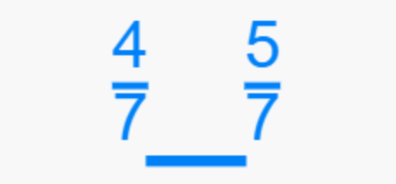
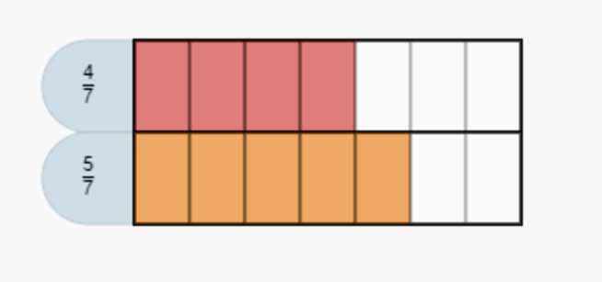
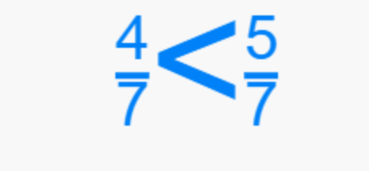
Like Fractions - Denominators
Notice
However
So
Same denominator, so the parts will be partitioned the same.
Our numerators are different, so we will get a different number of shaded parts. The larger the numerator, the more parts we get.
4/7 is Less Than 5/7 because we are getting one less part.

Slide 4
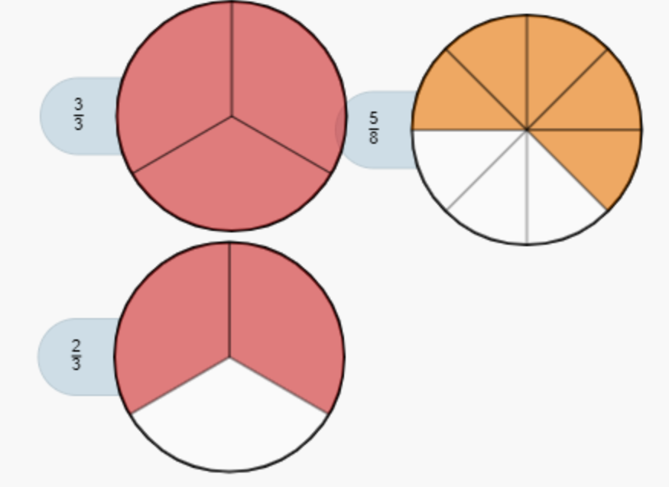
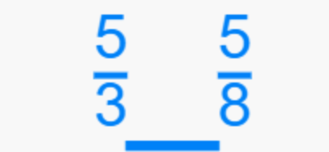
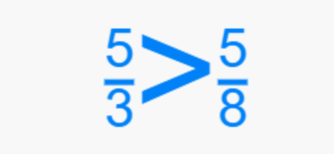
Greater, Less Than, or Equal to 1?
Notice
Therefore
So
In our first fraction, our numerator is larger than our denominator.
Our first fraction is more than one whole or greater than 1. A fraction that is equal to 1 has the same numerator and denominator (3/3).
5/3 is greater than 5/8 because 5/3 is greater than 1 and 5/8 is less than 1.

Slide 5
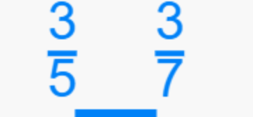
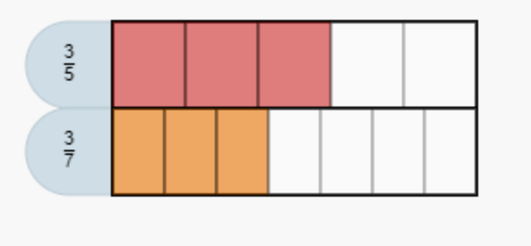
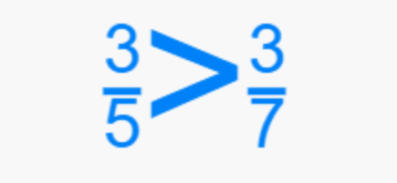
Like Fractions - Numerators
Notice
However
So
Same Numerator, so we are getting the same number of Parts.
Our Denominators are different, So our Parts will be different sizes. The Larger the denominator, the smaller our parts get.
3/5 is greater than 3/7 because we are getting 3 bigger parts.

Slide 6
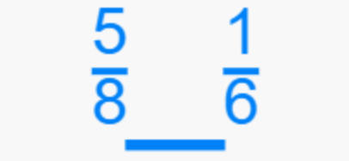
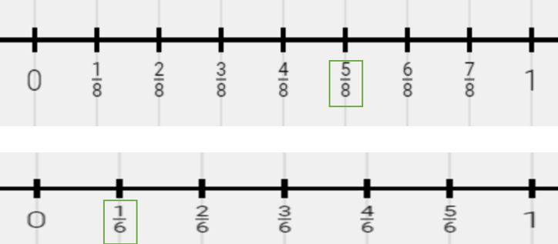
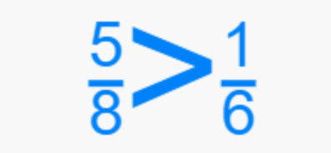
Unlike Fractions – Compare Using Benchmark Fractions
Notice
However
So
There are different numerators and denominators.
I know that 5/8 is greater than ½ because ½ of 8 is 4. I also know that 1/6 is less than ½ because ½ of 6 is 3.
5/8 is greater than 1/6 because 5/8 is close to 1/2 and 1/6 is close to 0.

Slide 7
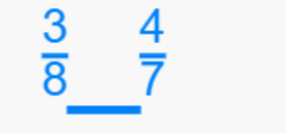
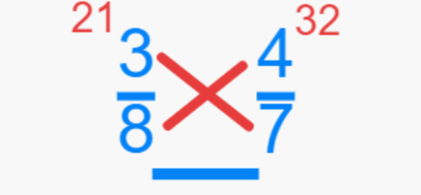
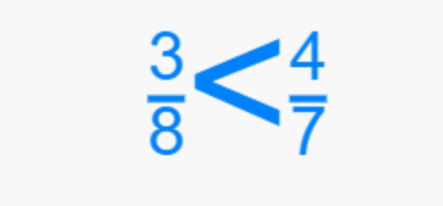
Unlike Fractions – Compare By Cross Multiplying
Notice
However
So
There are different numerators and denominators.
Here’s a Little Trick you can try. Multiply the numerator of your first fraction by the denominator of the second fraction. Then multiply the numerator of the second fraction by the denominator of the first fraction.
3/8 is less than 4/7 because 21 is less than 32.

Slide 8
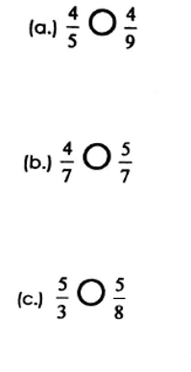
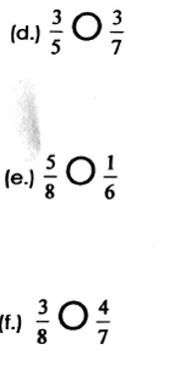
Which Fraction in each pair is Greater? Use Symbols >, =, or < to compare. Explain your reasoning.

