Slide 1
Decimal Fractions

Slide 2
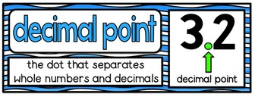
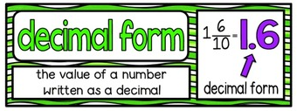
Vocabulary

Slide 3
What are decimal fractions?
Decimal Fractions are fractions that have denominators that are multiples of 10. They can be written as a fraction, decimal, or percent.
These are decimal fractions…
$$\frac{3}{10}$$
$$\frac{4}{10}$$
$$\frac{54}{100}$$
$$\frac{75}{100}$$
$$\frac{60}{100}$$
$$\frac{30}{100}$$

Slide 4
Task 2: Represent the following fractions using base-ten models.
$$\frac{3}{10}$$
$$\frac{4}{10}$$
$$\frac{54}{100}$$
$$\frac{75}{100}$$

Slide 5
Task 2: Represent the following fractions using base-ten models.
$$\frac{60}{100}$$
$$\frac{30}{100}$$

Slide 6
Place Value
This is a place value chart that shows the decimal places for tenths, hundredths and thousandths.
Decimal Point
1 2 3 . 4 5 6
Tens
Ones
Tenths
Hundreds
Hundredths
Thousandths

Slide 7
What is a decimal?
Decimals represent a part of a whole.
When writing decimals you need to place the number(s) to the right of a decimal point.
Examples:
0.3
0.54
You say this number by saying three tenths.
You say this number by saying
fifty-four hundredths

Slide 8
What is a Percent?
A percent represents a part of a whole
When writing a percent you need to include a % symbol to the right of the number
Example:
75% of the base-ten model is shaded in.

Slide 9
Fractions, Decimals, and Percents
Fractions, Decimals, and Percents are all parts of a whole.
$$\frac{54}{100}$$
Let’s look at a base-ten model and then figure out the fraction, decimal , and percent that are represented by it.
Fraction
Decimal
0.54
Percent
54%

Slide 10
Let’s Practice
Look at the following base-ten model.
What fraction is shown in the model?
$$\frac{7}{10}$$
What decimal is shown in the model below?
0.7
How do you say this number?
Seven Tenths

Slide 11
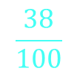
Let’s Practice
Look and the following base-ten model.
What fraction is shown in the model?
$$\frac{38}{100}$$
What decimal is shown in the model?
0.38
How do you say this number?
Thirty-Eight Hundredths
What percent is shown in the model?
38%

