Slide 1
Decompose means to break the numbers apart.
What does decompose mean?
This can be demonstrated with numbers and fraction models.

Slide 2
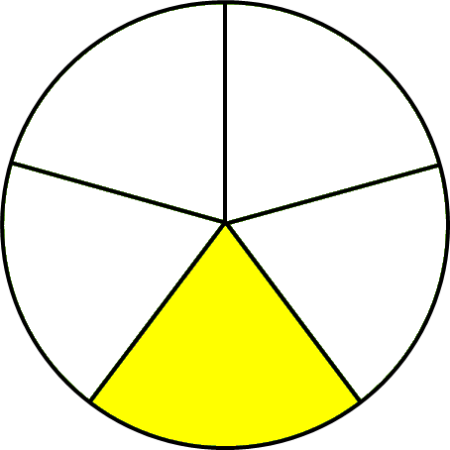
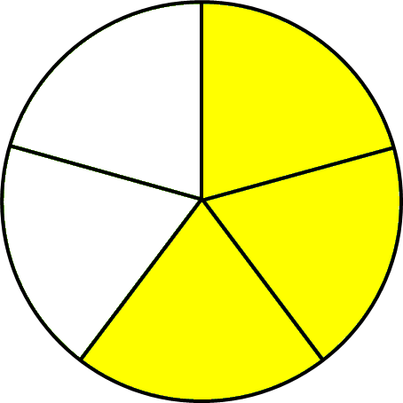
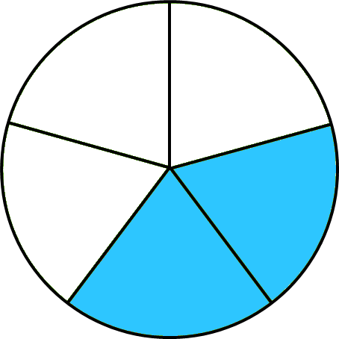
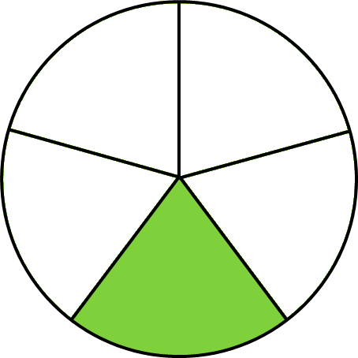
Step-by-Step
Only the numerator will be decomposed.
Look
at the fraction.
The number 4 can be decomposed in various ways.
1 + 3
or
2 + 2
or
1 + 1 + 1 + 1
Decompose the fraction the same way.
$$\frac{4}{5}$$
$\frac{1}{5}$ + $\frac{3}{5}$
$\frac{2}{5}$ + $\frac{2}{5}$
$\frac{1}{5}$+ $\frac{1}{5}$ + $\frac{1}{5}$ + $\frac{1}{5}$

Slide 3
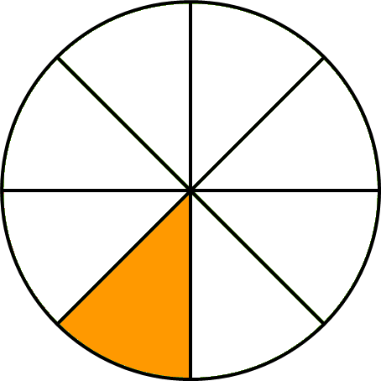
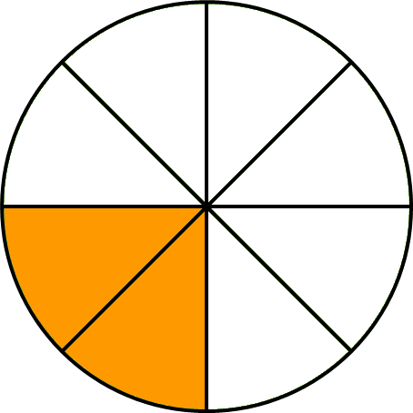
Step-by-Step
Only the numerator will be decomposed.
The number 3 can be decomposed in different ways.
Let’s try another one.
1 +2
or
1 + 1 + 1
Decompose the fraction the same way.
$$\frac{3}{8}$$
$\frac{1}{8}$ + $\frac{2}{8}$
$\frac{1}{8}$+ $\frac{1}{8}$ + $\frac{1}{8}$

