Slide 1
Main Ideas and Details
V.I.P. Strategy – Nonfiction

Slide 2
V.I.P. - Nonfiction
Flag an important fact or sentence.
Write a few key words.
Use the key words to write a main idea statement.

Slide 3
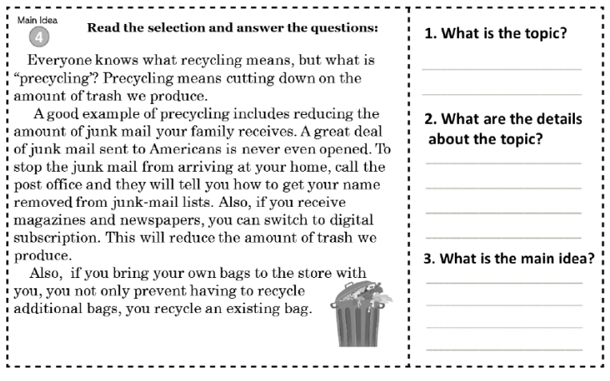
Flag an important fact or sentence.

Slide 4
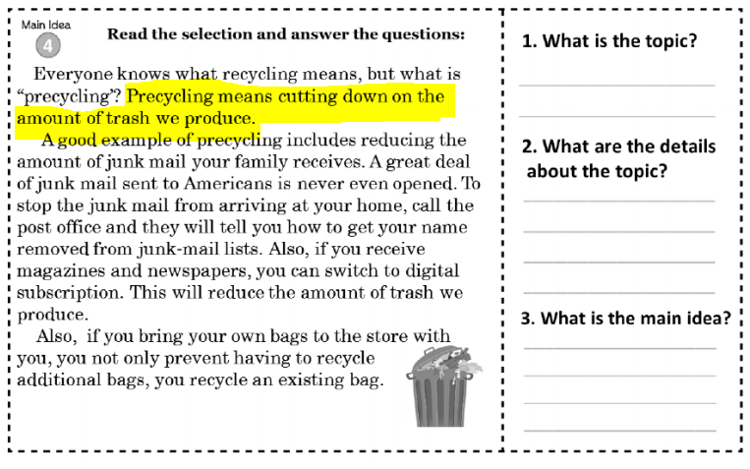
Flag an important fact or sentence.
Precycling means cutting down on the amount of trash we produce.
Precycling

Slide 5
Write a few key words.
Precycling

Slide 6
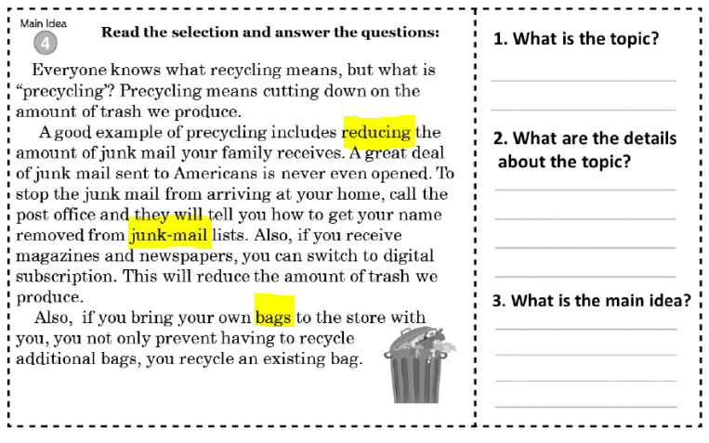
Write a few key words.
Reducing
Junk-mail
Bags
Precycling
Reduce junk-mail.
Bring your own bags to the store.

Slide 7
Use the key words to write a main idea statement.
Precycling
Reduce junk-mail.
Bring your own bags to the store.

Slide 8
Use the key words to write a main idea statement.
We can precycle (cut down on trash) by reducing our junk-mail and bringing our own bags to the the store.
Precycling
Reduce junk-mail.
Bring your own bags to the store.
Reducing junk-mail and bringing your own bags to the store are two ways you can precycle.

Slide 9
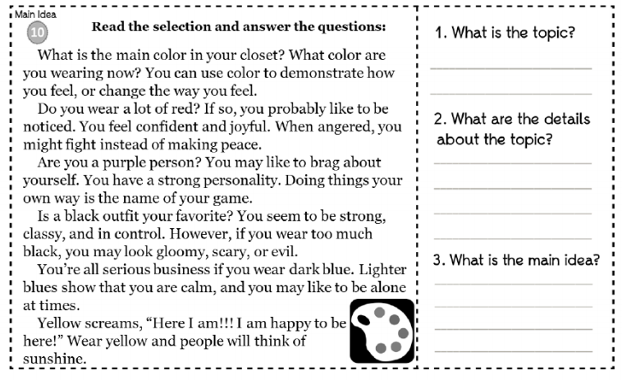
Now you try it!
What is an important fact or sentence?
What are a few key words?
How can we use the key words to write a main idea statement?

