Slide 1
Theme
THE MEssage

Slide 2
What is a story Theme?
The theme is THE MEssage or lesson the author wants you to learn from the story.
It can apply to your own life. (The ME)
There can be more than one.
It is a broad idea about life – not specific to the story.
It is usually not stated, it must be inferred.

Slide 3
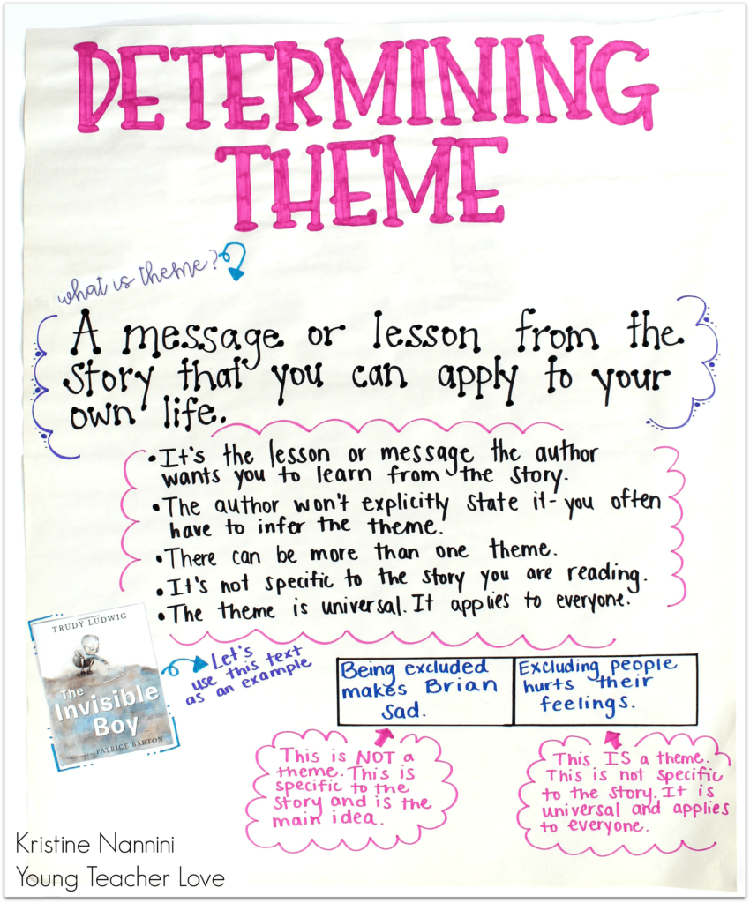
Here are some common Themes in fiction stories.

Slide 4
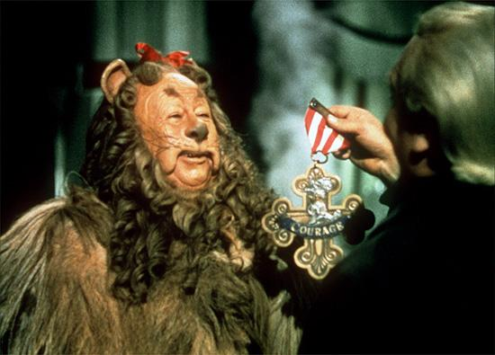
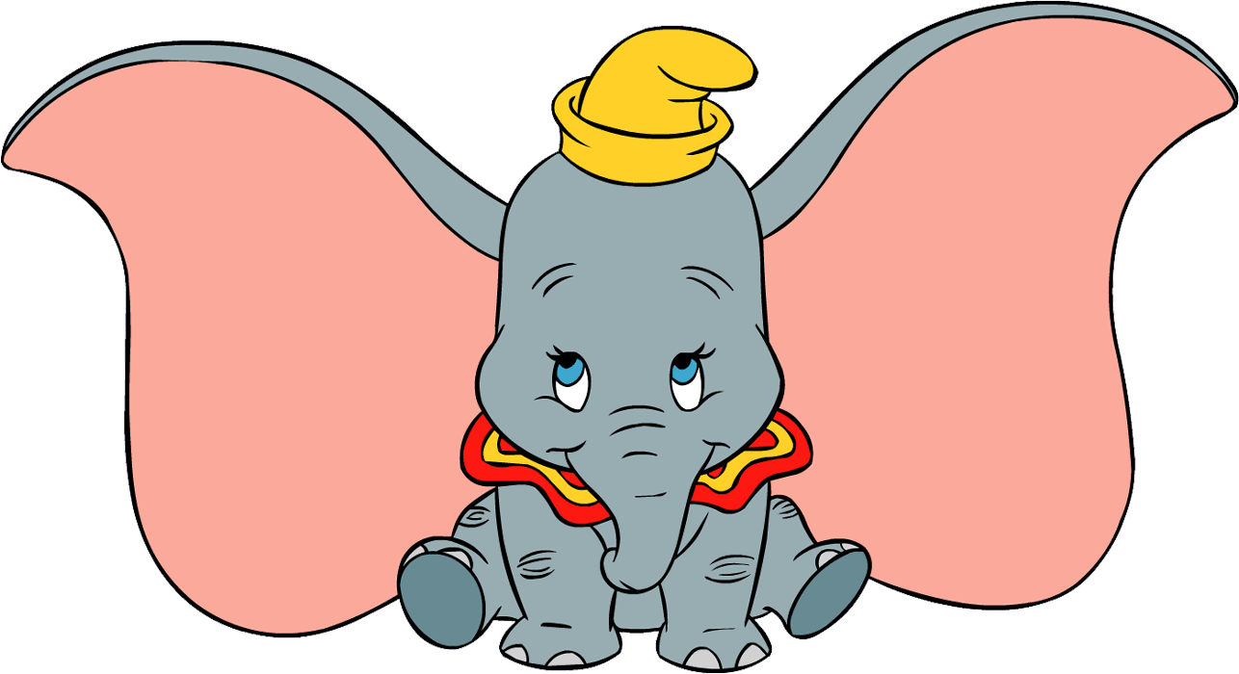
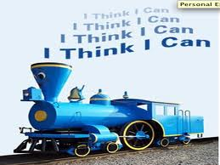
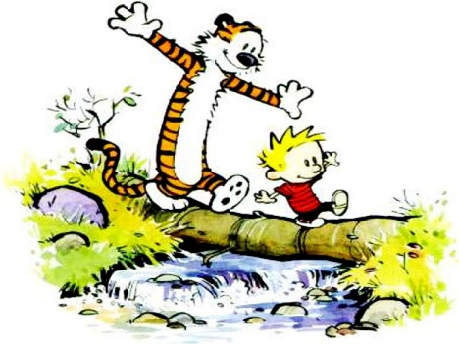
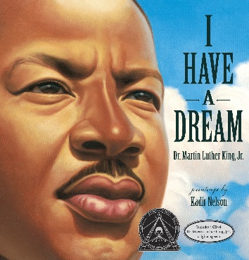
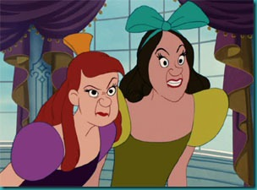
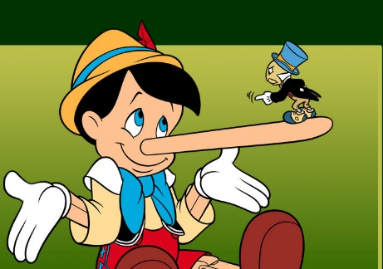
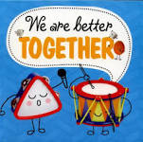
And there are so many more! Just think Lifeskills!
Believing in Yourself
Jealousy
Kindness
Courage
Friendship
Honesty
Differences
Equality
Cooperation

Slide 5
V.I.P. - Fiction
Action – What is the most important thing the character did?
Feeling – What is the most important feeling the character had?

Slide 6
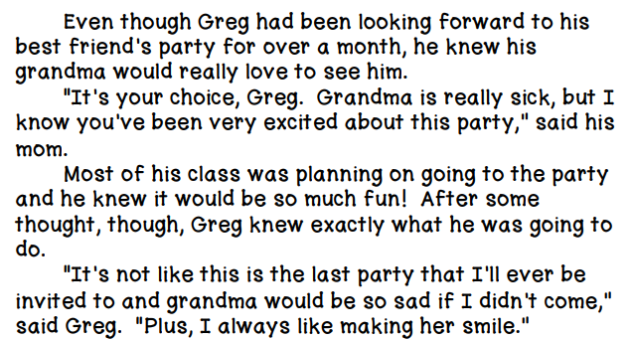
Let’s give it a try.
What is the most important thing the character did?

Slide 7
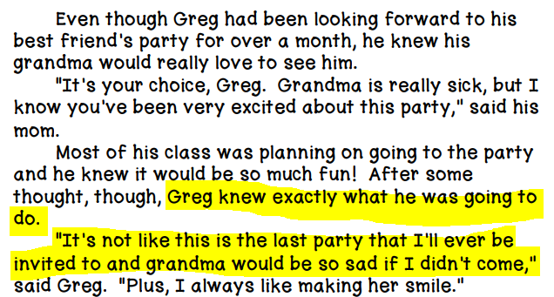
Let’s give it a try.
What is the most important thing the character did?
Greg chose to visit his grandma instead of attending the party.

Slide 8
Let’s give it a try.
What is the most important feeling the character had?

Slide 9
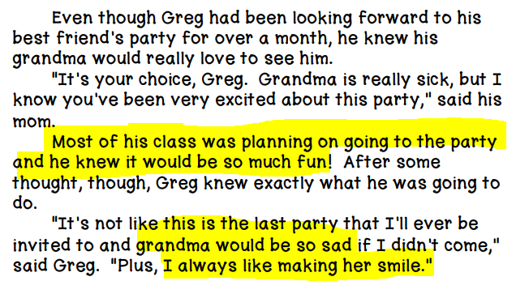
Let’s give it a try.
What is the most important feeling the character had?
Guilty/Conflicted – doesn’t want to upset anyone or miss out.
Happy – happy about his choice and the good feeling he gets from making grandma smile.

Slide 10
V.I.P. - Fiction
Let’s give it a try.
Action – What is the most important thing the character did?
Greg chose to visit his grandma instead of attending the party.
Feeling – What is the most important feeling the character had?
Guilty/Conflicted – doesn’t want to upset anyone or miss out.
Happy –about the choice he made and about making grandma smile.
From our character’s actions and feelings, what do you think is THE MEssage the author wants us to learn?
*Remember, there is usually more than one theme we can find in a story.*
Integrity – Making good choices.
Family – Family is most important.

Slide 11
Theme is a multiple meaning word…
Now we are using the word theme to mean “song”.
Let’s celebrate your great work today with a Snap & Cheer to the theme from the Addams Family!

